Slide 1

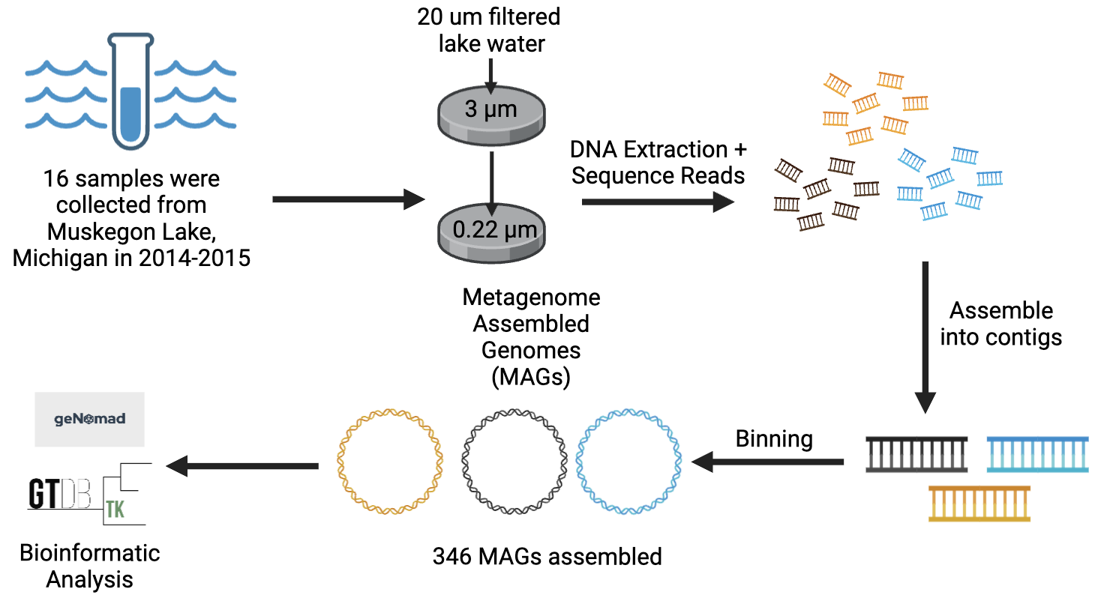
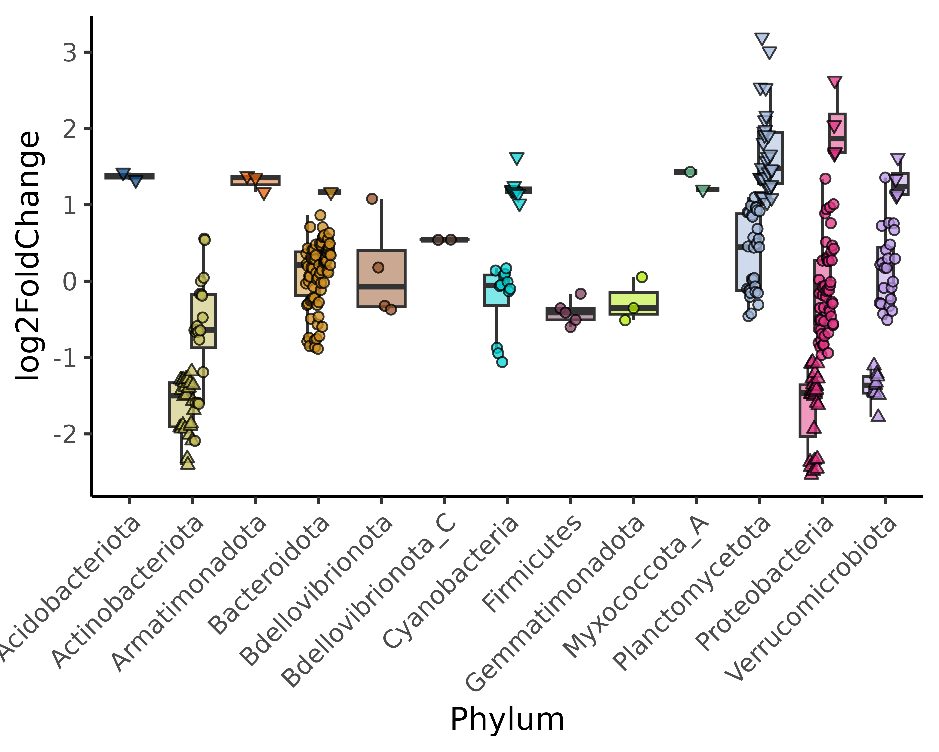
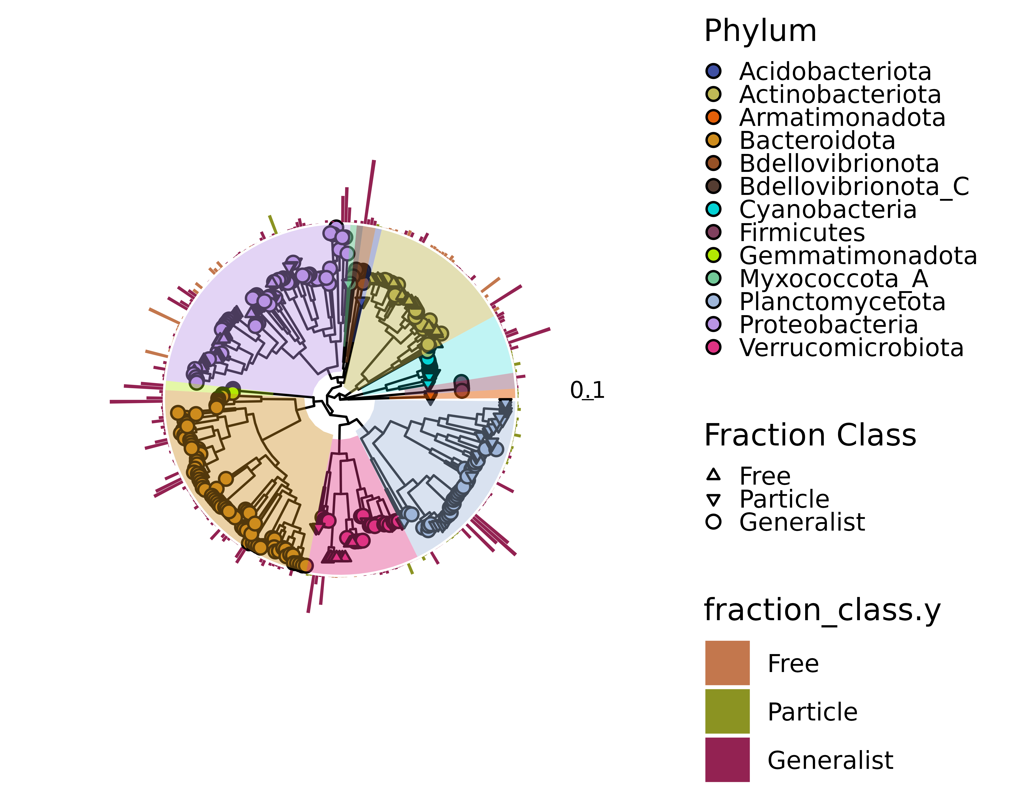
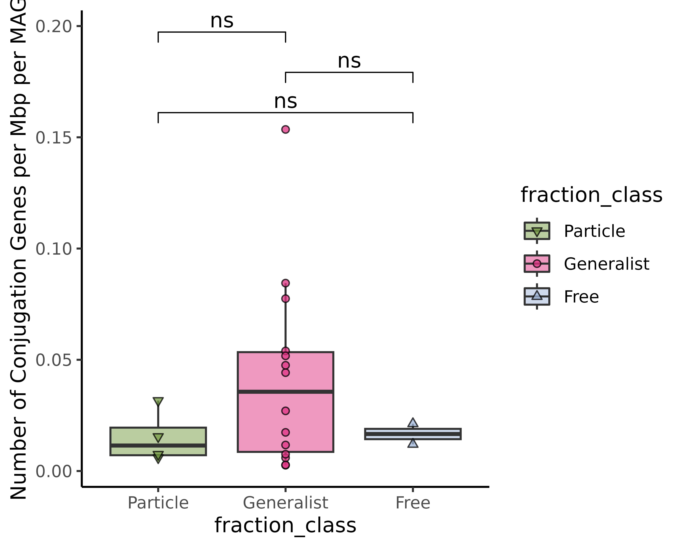
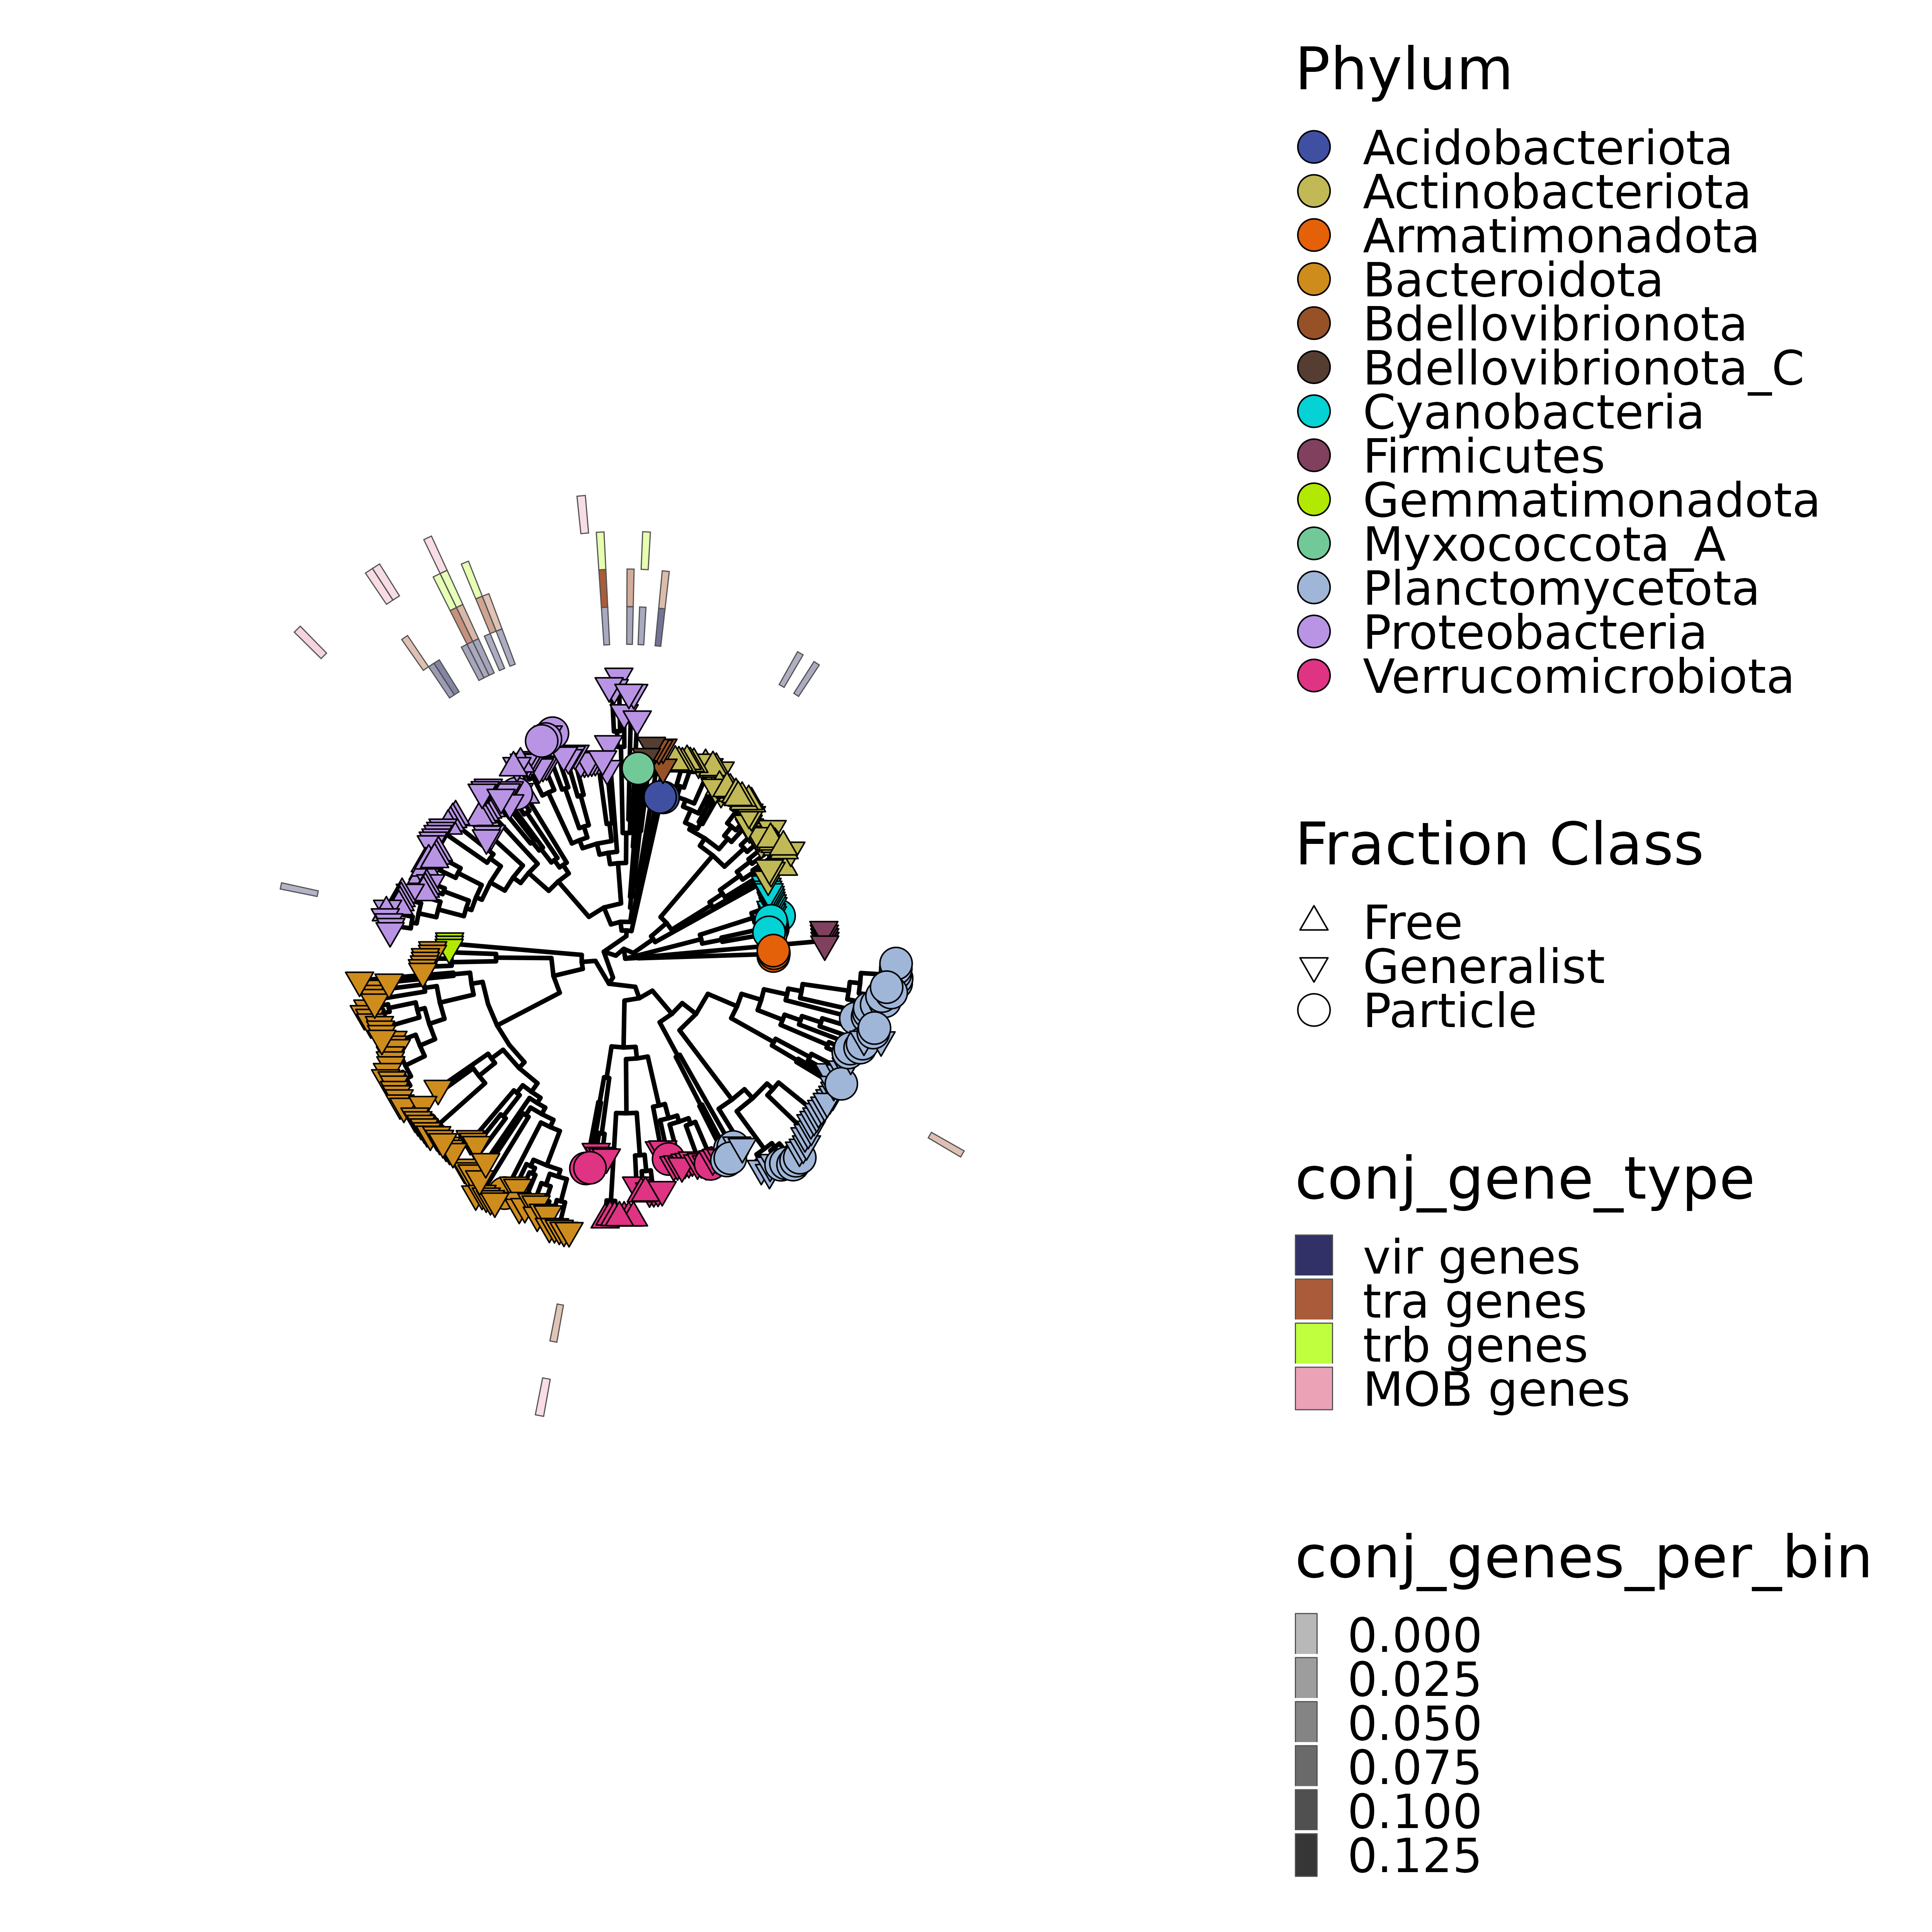
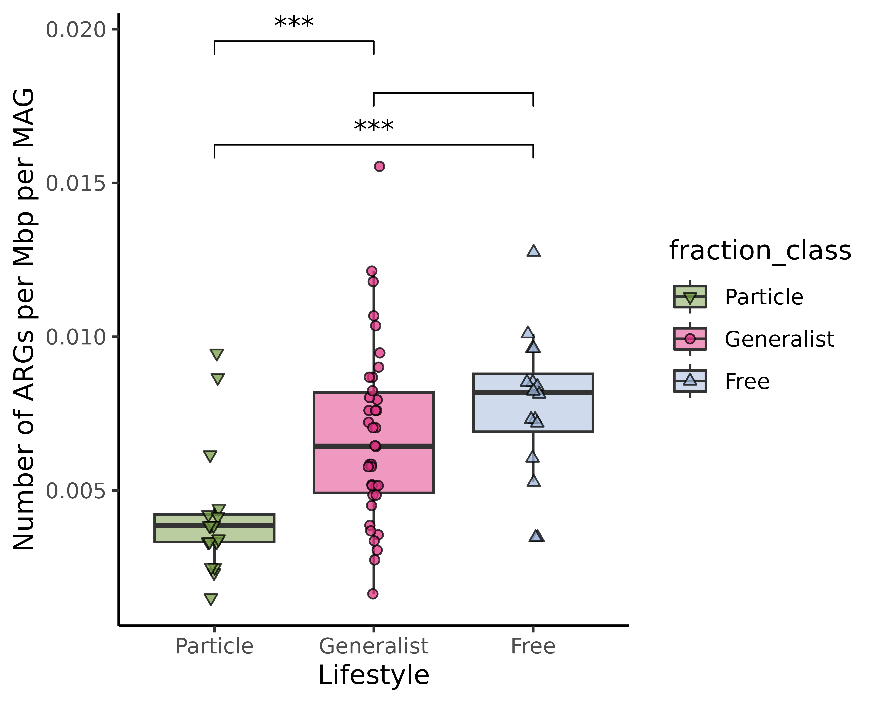
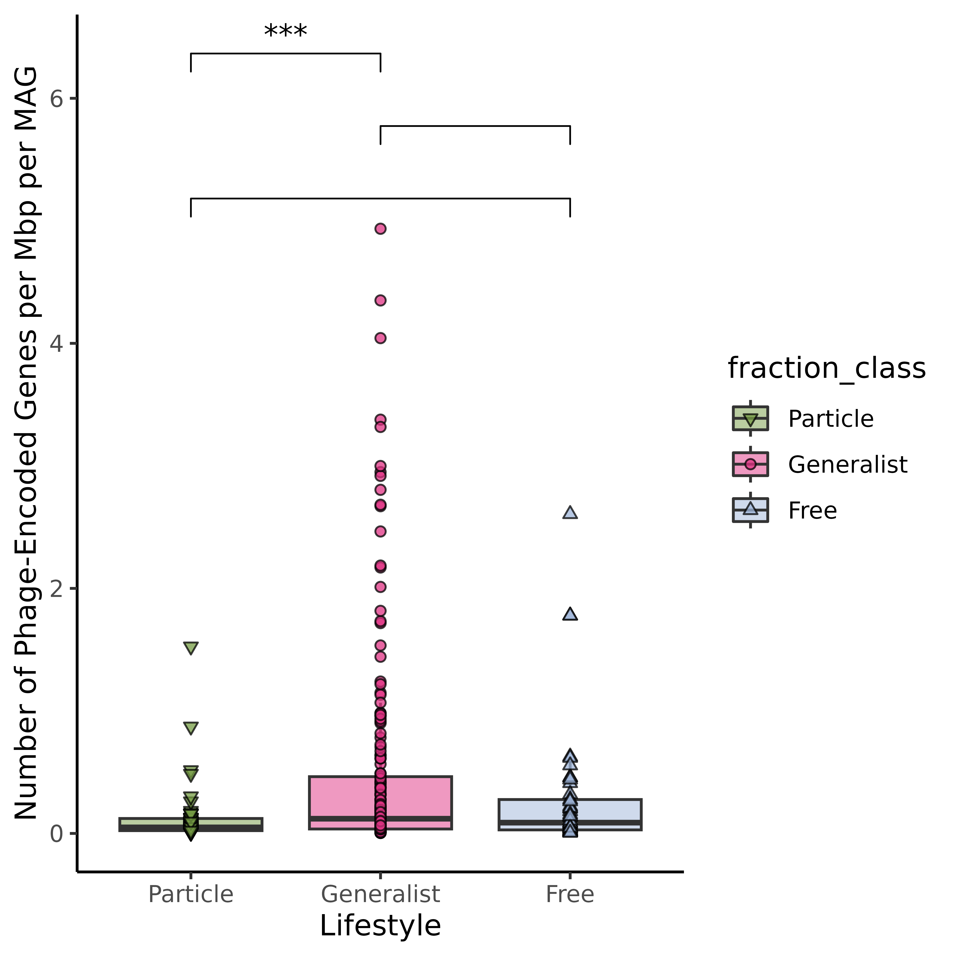
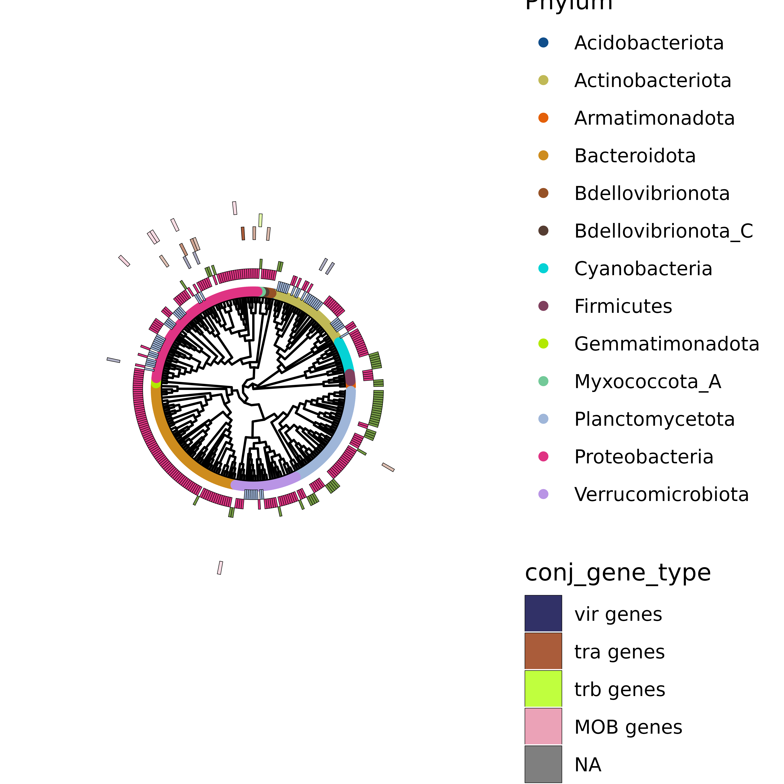
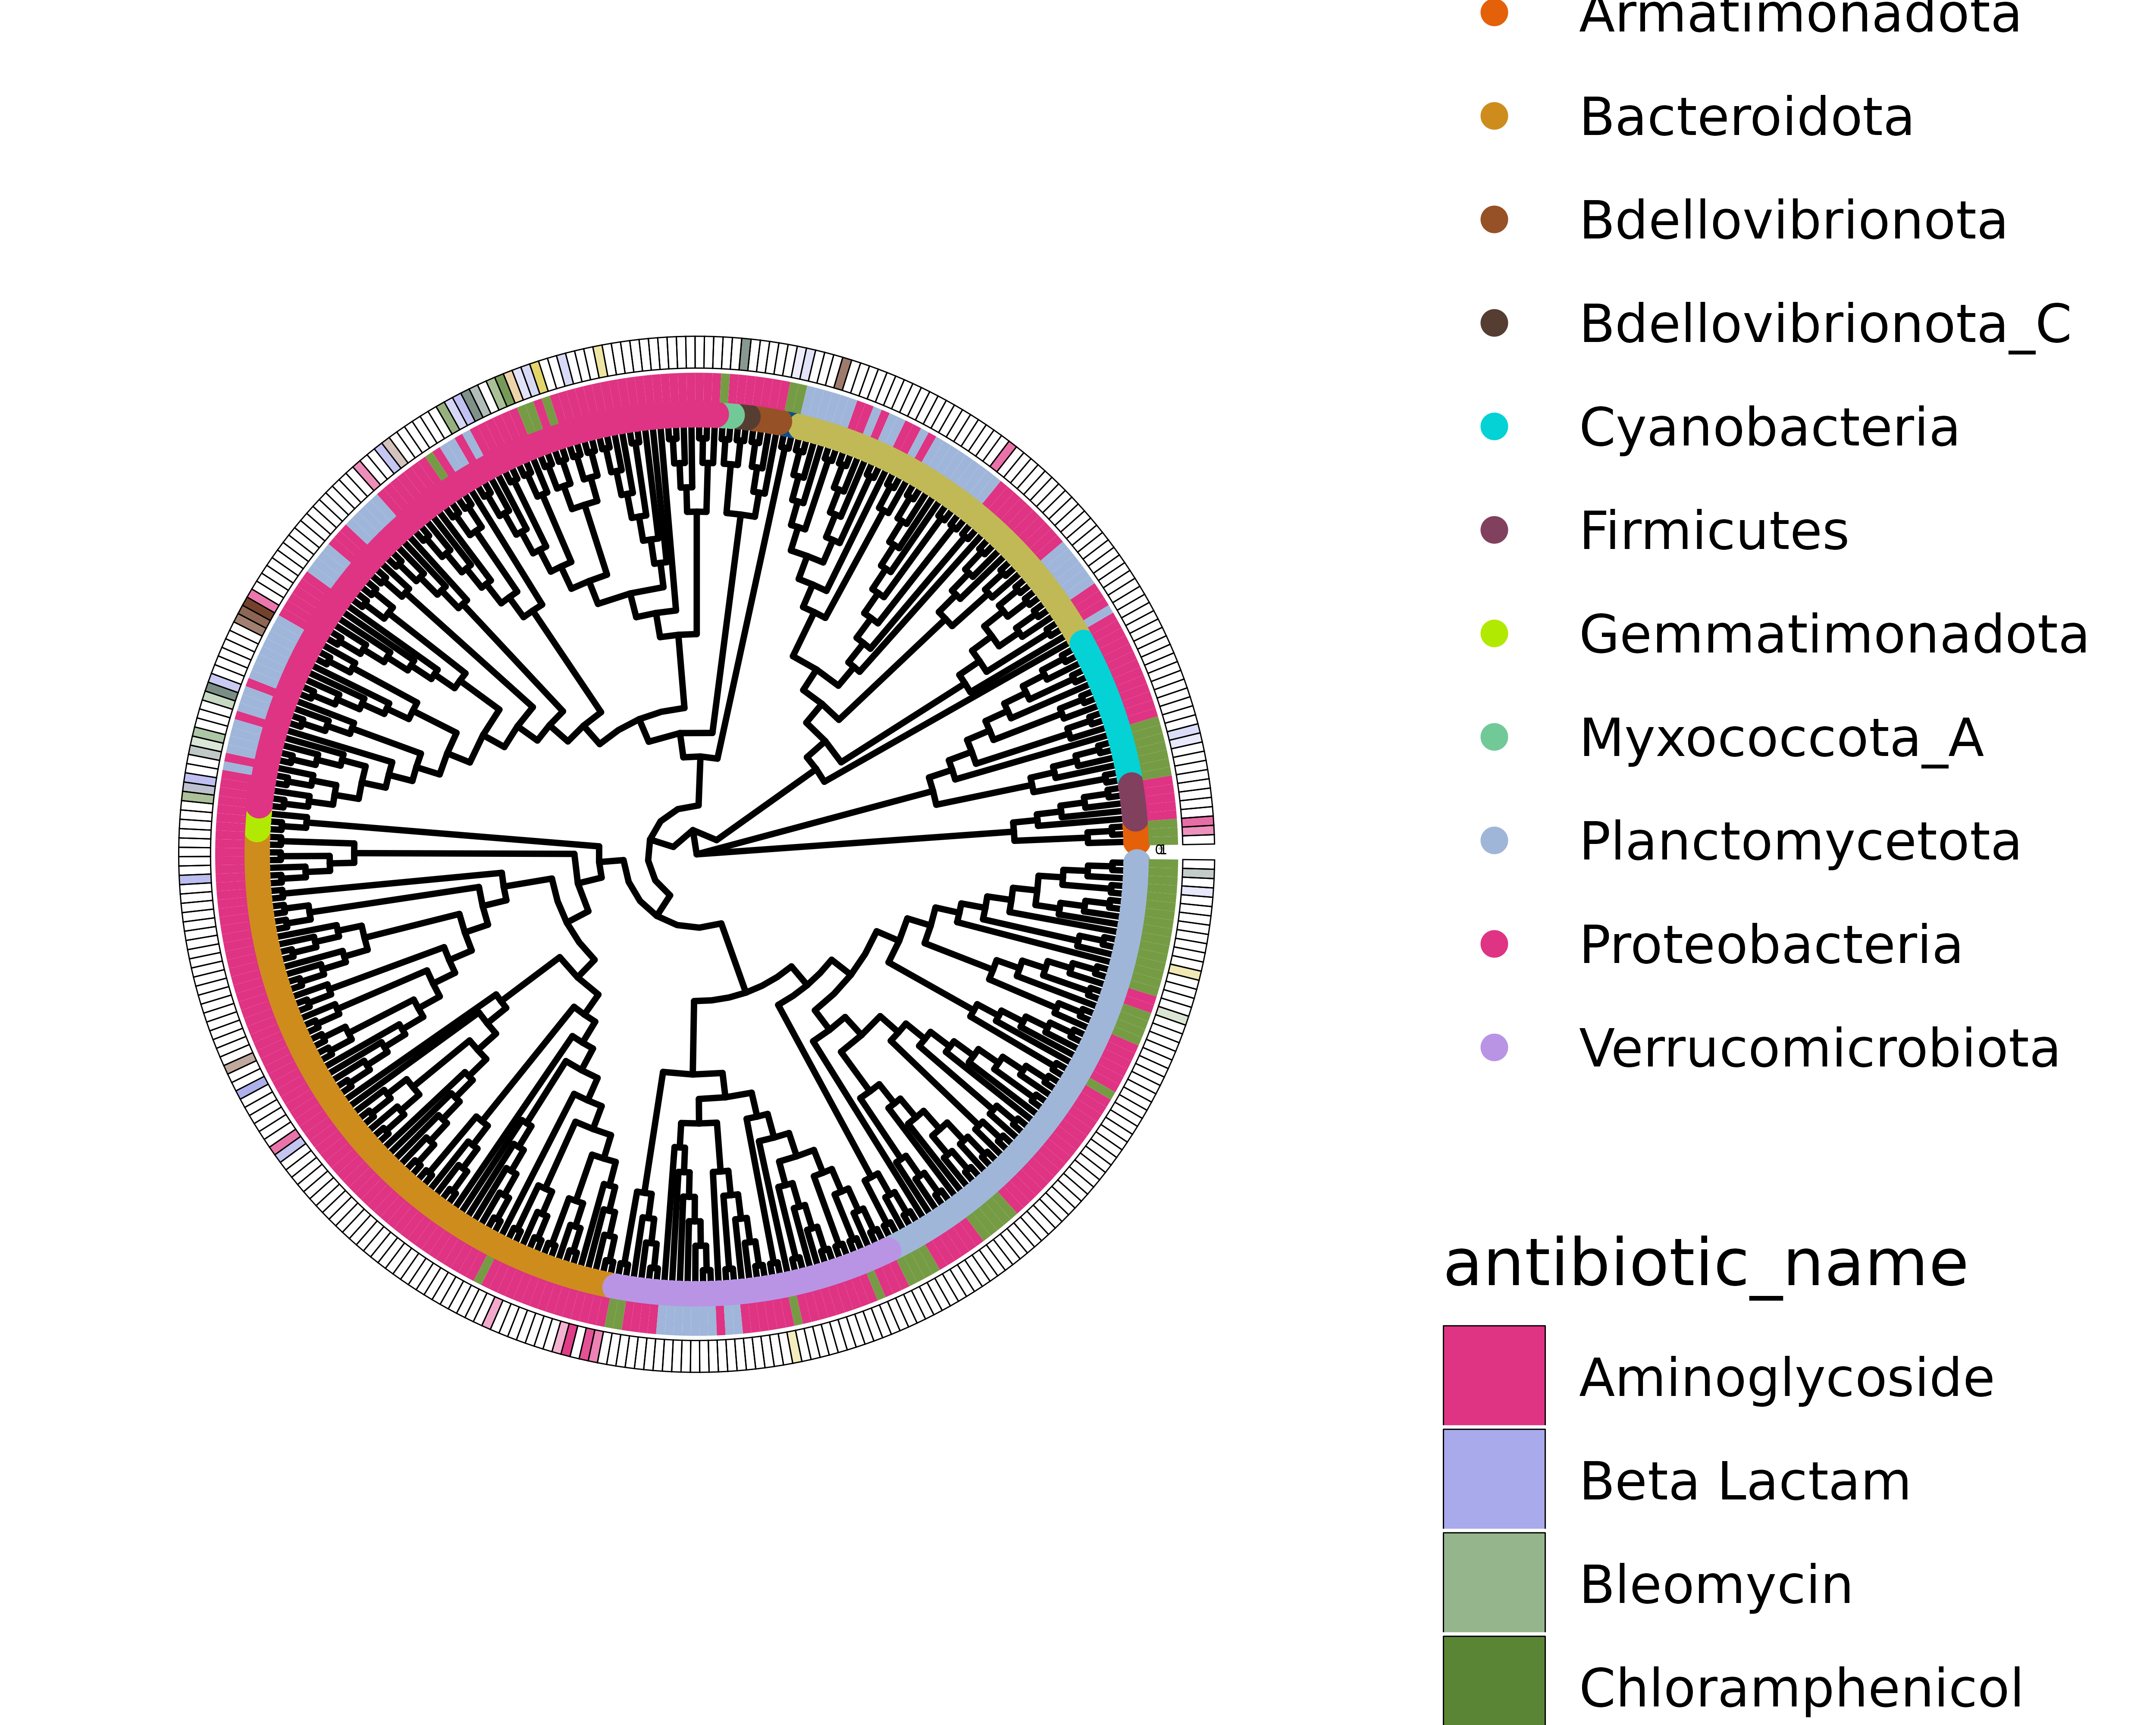
Bacterial Lifestyles Influence Mobile Genetic Elements in Aquatic Ecosystems
Sophia Aredas; Marian Schmidt, Ph.D.
Department of Microbiology, Cornell University, Ithaca, New York 14853
Mobile Genetic Elements (MGEs) ARE OVERLOOKED IN FRESHWATER MICROBES
CONSTRUCTING 346 MAGs FROM
SHORT READ SEQUENCING DATA
GENERALIST LIFESTYLES ARE
MOST COMMON
Intro: Anthropogenic disturbances, such as the overuse of antibiotics, threaten the diverse microbial species that inhabit and maintain the health of urban freshwater ecosystems (citation). In aquatic ecosystems, particles are hotspots of microbial activity where microbes can directly interact and acquire more nutrients compared to the microbes that live in the surrounding water, which has less nutrient availability (citation). This creates an opportunity for three bacterial lifestyles: (1) Particle-attached (PA) microbes that form microbial cohorts on particles for nutrients, (2) free-living (FL) microbes that inhabit the surrounding water column, and (3) bacteria that alternate between the two lifestyles (generalists).
Mobile genetic elements (MGEs) such as plasmids and bacteriophages are significant drivers of horizontal gene transfer (HGT) within microbial communities and may contribute to antibiotic-resistant bacteria. Plasmids that are self-transmissible encode mating pair genes to move themselves between hosts whereas mobilizable plasmids rely on self-transmissible machinery. Previous studies have reported PA microbes to have higher rates of plasmid transfer than FL taxa (citation). Yet the role and distribution of MGEs in freshwater metagenome-assembled genomes (MAGs) remains understudied, especially within bacterial lifestyles.
Question: Do microbes that live in close association with each other on particles have a higher amount of MGEs than those that live freely?
Hypothesis: If particles serve as hotspots of microbial activity and help to facilitate direct cell-to-cell contact, we hypothesize that PA and generalist microbes have enhanced opportunities to engage in HGT and will have higher rates of MGEs and antibiotic resistance genes (ARGs).
Particle Associated
Free living
Particle
Generalist
MetaBat2
CONCOCT
dRep
Free
MAG distribution: Particle = 15%, Generalist = 66.8%, Free = 18.2%
CONJUGATION GENES ARE PREDOMINANTLY FOUND IN GENERALIST SPECIES
GENERALIST SPECIES ENCODE THE MOST ANTIBIOTIC RESISTANCE GENES
PHAGE GENES ARE NOT PHYLOGENETICALLY CONSERVED
16.47% of MAGs encode antibiotic resistance genes
Pagel’s Lambda: 0.55, p-value = 1e-12
Bloomberg’s K : 0.003, p-value : 0.02, based on 999 randomizations
Pagel’s Lambda: 0.992932
(p-value = 3.56436e-54)
Bloomberg’s K : 0.0326016
(p-value : 0.001001)
(based on 999 randomizations)
Pagel’s Lambda: 0.242194
(p-value = 0.00922661)
Bloomberg’s K : 0.00182091
(p-value : 0.906907)
(based on 999 randomizations)
FUTURE DIRECTIONS
Analyze if lifestyle is a better predictor of phage infection rather than phylogeny
Conduct further bioinformatic analysis to understand how ARGs are being disseminated in the community by analyzing what transposable elements are responsible for mobilization.
Explore potential vectors of anthropogenic disturbances such as plastic pollution to understand how MGEs are entering the environment and interacting in the water column.
ACKNOWLEDGEMENTS
Thank you so much to Dr. Marian Schmidt, Gus Pendleton, and Sophia Richter for your support!
Thank you so much to BBM and Cornell University for conference support.
Notes:
https://microbiomejournal.biomedcentral.com/articles/10.1186/s40168-020-00863-4 this could be a really helpfuol. Paper they also did freshwater ARGs and viromics but found like 0.001% of reads are predicted to encode ARGs. Also they were able to find 3 new class A beta lactamases and compared them on a tree so that’s really neat we have a bunch of those as well in our database but they couldn’t find them through CARD they were only able to be predicted through Resfams so I should also check that out because its created for functional metagenomics but it was last updated in 2015 so idk how reliable it is? Update: resfams as of 2022 has been unavaialable which isn’t shocking
Put result in the title
More

